Slide 1
MarCom to MarTech:
Succeeding in 2018 and Beyond
Carla Bryant & Mike Schneider
mschneider@greystone.net
carla@corriganconsulting.com

Slide 2
Being Digital
A recent study from Facebook and Deloitte found that most marketing organizations are “doing digital” not “being digital.”
Making incremental changes rather than weaving digital into its marketing DNA; this finding was consistent regardless of size, industry or geography.
For the Modern
Marketing Operation:
Technology is the
New Creative

Slide 3
In the last decade, marketing has gone from being one of the least tech-dependent business functions
to one of the most.
  Scott Brinker
  www.chiefmartec.com

Slide 4
What’s Driving the Change?
The Digitalization of the World
Open Information
Social
Customer Experience
Source: A Brand New Marketing

Slide 5
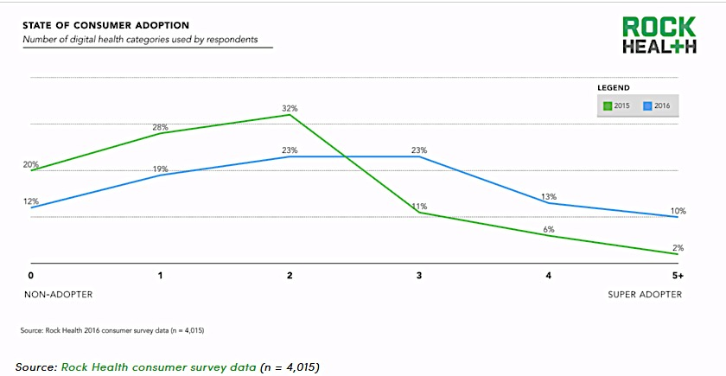
Digital Health Adoption:
A Tipping Point
46% are now considered active digital health adopters, having used three or more categories of digital health tools.
Only 12% of Americans are non-adopters.
In 2016, consumers adopted digital health tools at a record rate.

Slide 6
The Arrival of MarTech
MarTech is leveraging technology, software and data to build profitable customer relationships by creating value for customers and capturing value in return.
MARTECH
MARCOM
Promoting and selling goods and services.
MARKETING
TECHNOLOGY
So virtually anything involved with web applications and/or digital marketing is MarTech, since both are technologically-based.

Slide 7
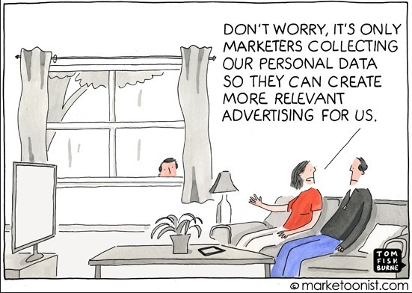

Slide 8
Illustration: Scott Brinker

Slide 9
Trends to Watch
The continued rise of the empowered customer.
The emergence of mixed reality – virtual and augmented.
The impact of machine learning, artificial intelligence, and the Internet of Things (IoT) devices.
The inevitability of mobile-only customers.
Merging the art and science of marketing.

Slide 10
The Rise of the Empowered Consumer
Consumerism: “A movement that advocates patient involvement in their own healthcare decisions.”

Slide 11
The retail world is learning healthcare faster than healthcare is learning retail.
Rob Klein, Klein & Partners

Slide 12
Powerful, but frustrated
Consumers have emerged as the fastest growing payer in healthcare
Confused as they try to discern the cost and value of care.
Pricing is meaningless without quality data. According to Leah Binder, CEO Leapfrog, “97% of customers surveyed preferred hospitals with the highest grade of safety”.
Over half of consumers want to receive their care from a single brand.
7 in 10 feel responsible for managing their own health, but don’t have tools
4 of 5 find it hard to compare cost and quality
3 in 10 are have deferred treatment to avoid the confusion and expense
3 of 4 feel healthcare decisions are the most important and expensive they will make
Source: The Consumer is the New Payer in Healthcare. NRC, 2017.

Slide 13

Reviews - The New Word-of-Mouth
Consumers rely heavily on reviews to make decisions about providers and hospitals.
Reviews on third party sites are most important
The overall tone and content of the review, and the total number matters in their evaluation
Consumers will change providers/hospitals if they find compelling negative reviews.
Neither ranking/ review sites are useful in choosing a hospital
Millennials – 12%
Older – 28%
Prefer
quality ranking organizations over consumer-driven reviews to help choose a hospital
Millennials – 52%
Older – 34%
Gone online to a hospital’s website and shared experiences about a hospital or doctor
Millennials – 32%
Older – 17%
Gone online to a social site & shared experiences about a hospital or MD
Millennials – 45%
Older – 10%
Source: Millennial & Digital Healthcare Behaviors. Klein & Partners, 4th Quarter 2016 Ominibus Study.
Notes:
Facilities are often their own billboards – brand image = reviews – facilities, online reputation, facilities not an opportune

Slide 14

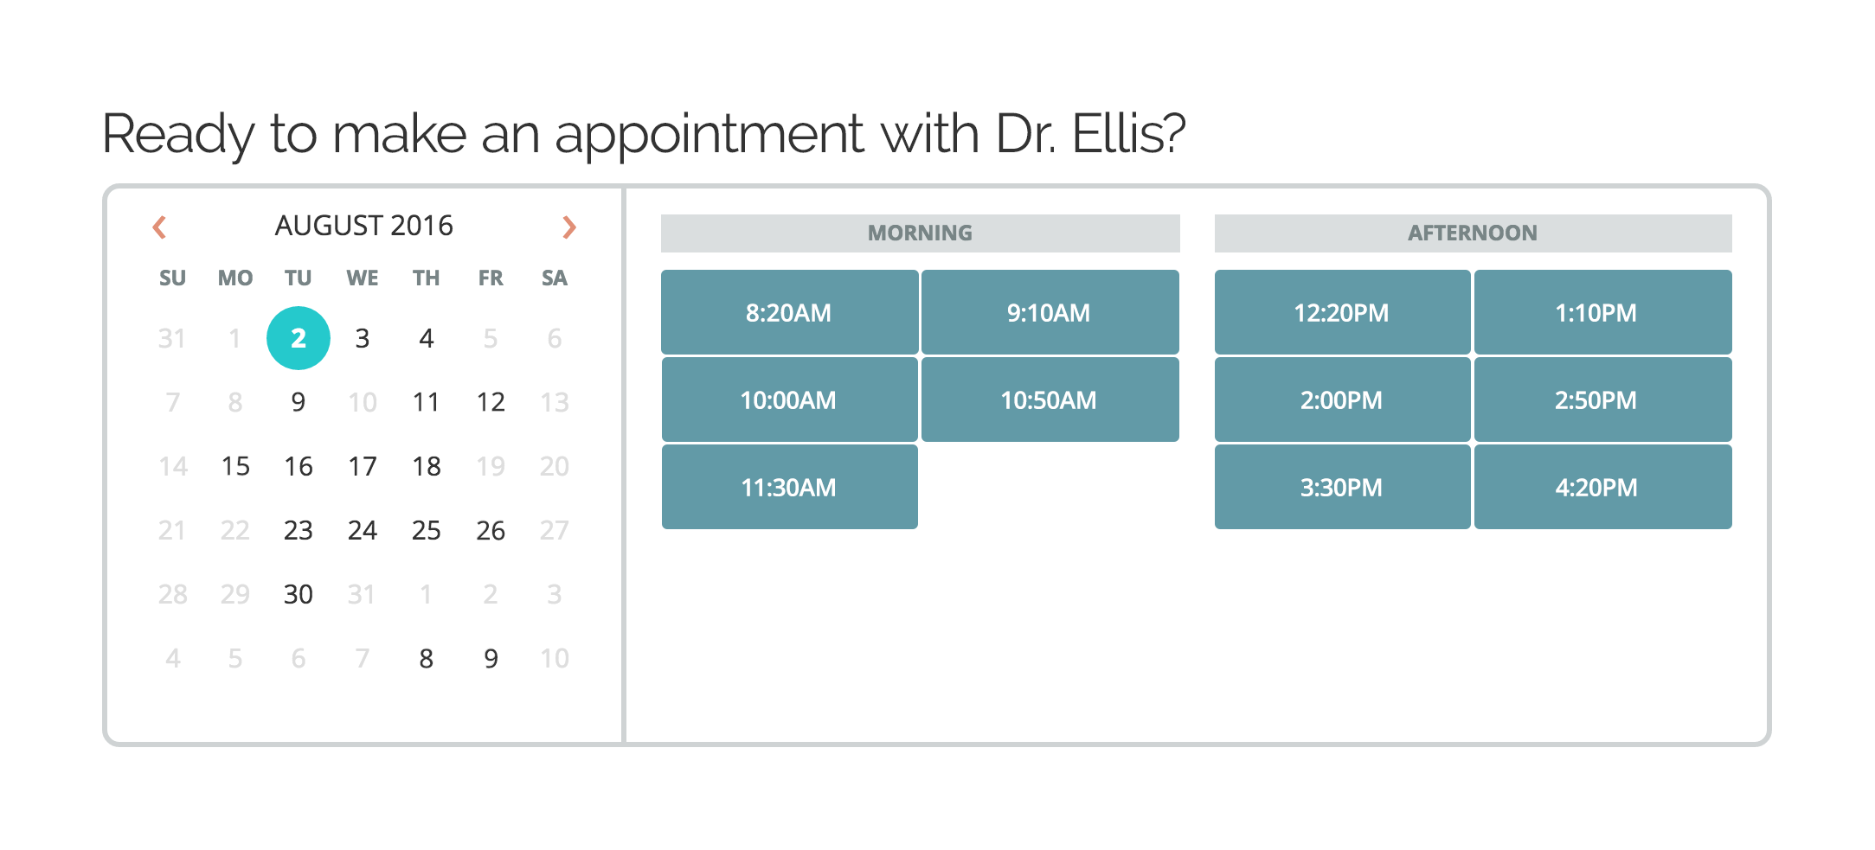
Convenience Over Location
80% Prefer Providers with Online Scheduling
67% choose online scheduling over location; 33% say online scheduling will increase the likelihood of making an appointment.
Self-scheduling is ground zero for health systems.
Source: Stax Online Scheduling Study 2016
Notes:
All things equal in providers, 80% of consumers will prefer providers that offer scheduling
Whenever and wherever…
In the age of instant access, consumers expect convenience.
Today, far more people visit us online than visit our facilities. Our reputation, and our brand exist every bit as much in a virtual, online marketplace than will ever receive care in your communities. even though the moments that really matter – where we deliver care—still largely happen in our clinics and hospitals.
These data include convey that consumers are determining preference

Slide 15
The Rise of the Machine

Slide 16
The New Marketing Currency
Data is becoming the currency of marketing and marketers will have access to more data than ever. Leveraging AI tools to process data more efficiently and uncover new insights faster provides a significant competitive landscape. Business models are undergoing profound changes. Marketers can no longer buy customer loyalty. It must be earned through engagement and value.
Frank Palermo
Head of Global Technical Solutions Group - VirtusaPolaris

Slide 17
By 2020
80% of B2B marketers predict AI will revolutionize marketing by 2020
Only 10% of them are currently using AI for their businesses

Slide 18
AI in Marketing
Both creative activities and customer experience have the potential to be impacted by AI and machine learning:
  More mundane creative activities will become increasingly automated (especially combining machine learning with automation) to enable faster content development and campaign delivery.
  Customer, social and other data can be ingested by AI much more quickly and completely to provide better customer experiences across digital touch points.
  Machine learning could be used to offer better “recommended products and services” based on prior purchase and search behaviors.
  Right now, machine learning is applied mostly to programmatic advertising and segmentation.

Slide 19
Avalanche of Connected Devices
Virtually any physical product has the potential to be connected to the internet:
  Landscape watering
  Infant monitoring
  Home security
  Elder care
  Pet care
  Door locks
  Coffee makers
  And we are already living with Apple’s Siri, Microsoft’s Cortana, Amazon’s Alexa and so much more.

Slide 20
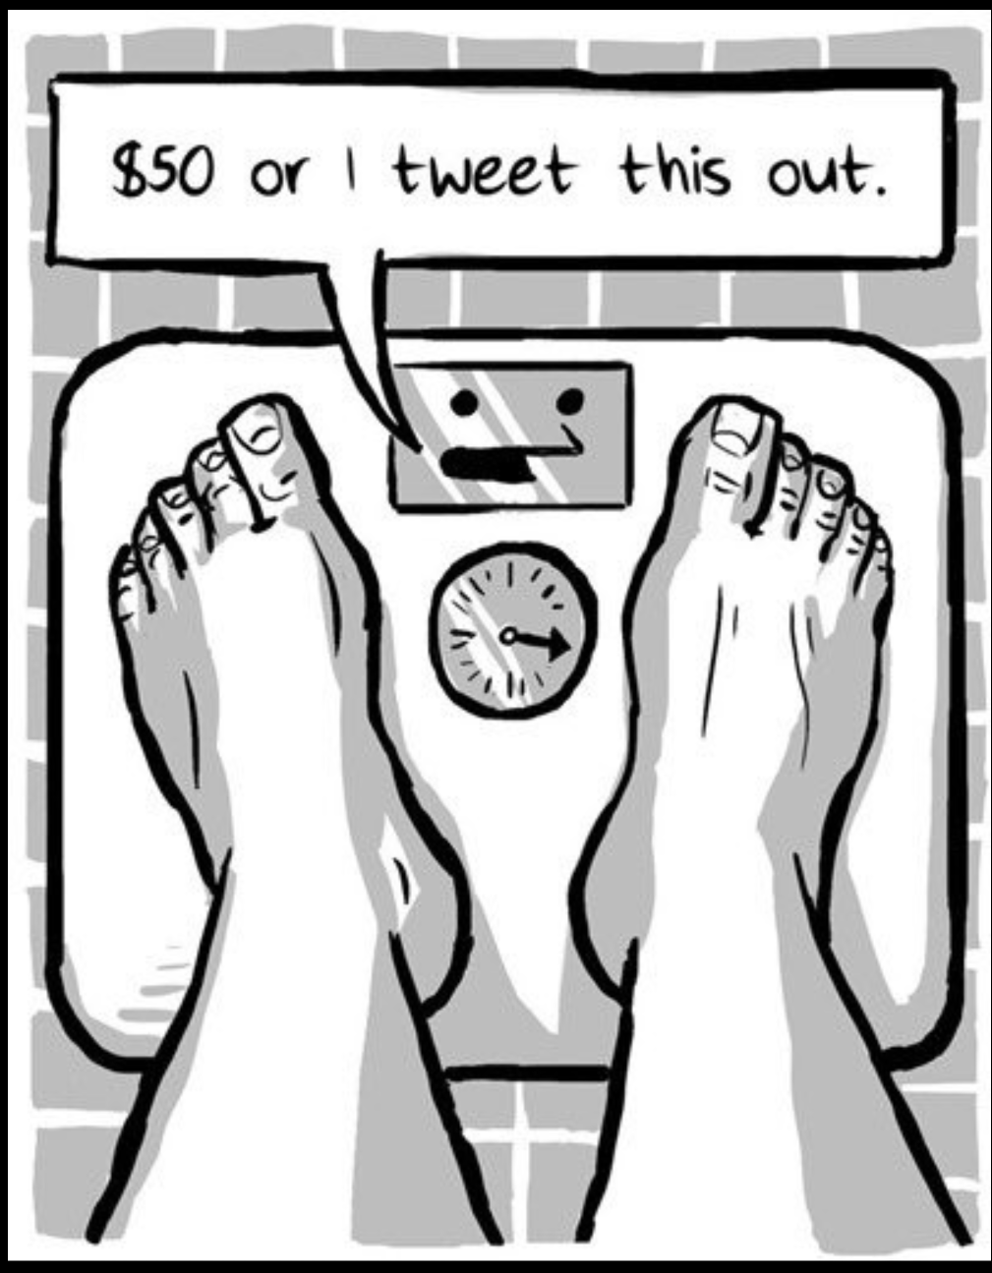
IoT
Can this new channel be used for your brand portfolio to grow volume, reputation, etc.?
Can the data generated by all these new devices and sensors be used for marketing purposes?
Is there an IoT device or function that would serve a B2B purpose with referring physicians, agencies, others?

Slide 21
The Future is Now
Natural voice recognition systems like Amazon Echo and Google Home work with app ecosystems like Spotify, Nest, Uber, etc.
HealthTap, Heal, and Boston’s Children’s are all using voice-driven skills to assess symptoms and in the instance of Heal and Health Tap – interact with providers
What changes when your customers or patients can search for information or order the latest gadget from Amazon with their voice? How do you market then?
  SEO and keywords less useful and valuable.
  Marketers will need to learn how to use the technology in the right way to reach their customers.

Slide 22
The Inevitability of the Mobile- Only Customer

Slide 23
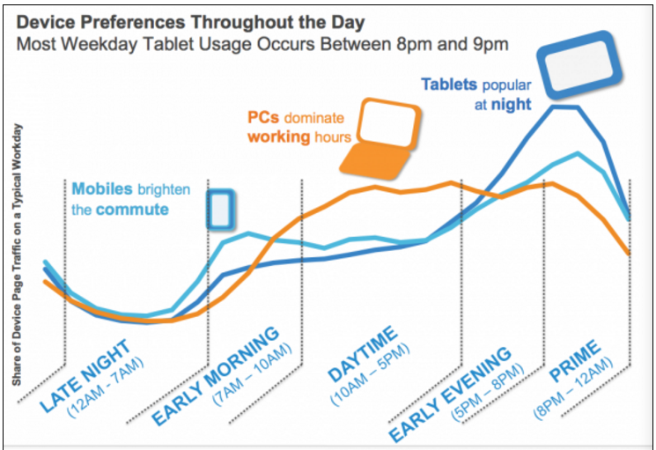
Mobile is Core to Our Lives
As of 2016, there were 2.6b smartphone users worldwide and predicted to grow to 6.1b by 2020.
Includes 81% of all US adults
Smartphone use has more than doubled since 2014.

Slide 24
Mobile does not mean an app
Consumer behavior is changing
  In early days, consumers would download more than 10 apps a month
  Today’s users average downloading zero apps a month
  In fact, 80% of app use is spent within a user’s top three apps.
This is leading to the incorporation of services through other apps, AI assistants and mobile operating systems.
More and more are being integrated into iMessage, Google Assistant, Siri, Alexa, chatbots and more.

Slide 25

Think Mobile First
For years, we've said that the website is a health system’s new virtual front door.
Mobile is the new gateway to your brand.
Your mobile presence is your hospital’s new virtual front door.
Many companies still treat mobile device experiences as an extension of the desktop web experience – one that precedes tablets, smartphones and tablets.
Think mobile first
  Websites optimized for mobile and responsive
  eMails optimized for opening on a mobile device
  Cater to a mobile audience in your marketing and app development.
Integrate mobile with CRM and marketing automation systems.

Slide 26
Balancing the Art and Science of Marketing

Slide 27
Digital Transformation of Marketing
Better cognitive insights will revolutionize how marketers deepen customer connections.
Marketing in this cognitive era means:
  Mobile, web, social, search, CRM, marketing automation – integrated with enterprise IT systems – are no longer optional to remain competitive.
  Data analytics must become a new core competency of the marketing department
  We must use insight and technology in new ways that elevate the entire customer experience, creating singular yet cohesive moments throughout the customer journey tailored to each person’s needs.
  We must leverage our creative skills to build connections with customers.
  Digital strategy must move from static websites to integrated, multichannel platforms that engage consumers in real time.

Slide 28
It is a Journey
While healthcare marketers have made great strides in many areas of their digital efforts, there is still much to be done and challenges that have not yet been conquered.
In particular, there is still significant work to be done in building healthcare’s understanding of and effective use of CRM strategies and tactics.
There is also work yet to be completed in building executive understanding of the digital transition and securing the needed resources to be successful long‐term.

Slide 48
Closing Thoughts
Illustration: Ion Interactive

Slide 49
The proliferation and sophistication of digital devices, big data technology platforms, and increasingly savvy customers accustomed to getting their way, have combined to create the perfect storm.
Source: Lisa Loftis, SAS Institute

Slide 50
The Practice of Marketing is
Forever Changed
Dramatic change is revolutionizing healthcare marketing – and much of that change is interconnected.
Every marketer – at every level – needs to become digitally savvy and data intelligent.
Today’s contemporary marketing department demands staff with new skillsets, fresh thinking, different priorities and new approaches to organizational structure.
Time to begin walking away from the siloes of “traditional” and “digital” marketing and realize it is all just MARKETING.

Slide 51
Cultural & Structural Issues Pose the Biggest Challenges for Marketers
Healthcare’s prevailing beliefs about marketing as “promotions”
Inflexible business processes and customer interface systems
Habitual priorities vs. new patterns of thought and action
Lack of data and analytics to inform marketing strategy
Organizational structure, capabilities, skills and resources
Difficulty finding and keeping talent

Slide 52
New Areas of Expertise
Today’s Marketing
Department Functions
Tomorrow’s Marketing Operations
Competencies & Expertise
Brand strategists
Service line marketers
Creative services
Public relations
Referral development
Web & social media
Events managers
Sales
Growth strategists
Data scientists
Experience engineers
Digital strategists
Marketing technologists
Social communicators
Brand journalists
Customer management

Slide 53
Thank You

